Slide 1
UBER - Demand & Supply Analysis
Prepared By :
Srivalli Munagapati

Slide 2
Abstract
Objective : To identify the root cause of gap between demand and supply of Uber Cabs and to provide recommendations.
Strategy : To Split the provided Data and perform Univariate, Segmented & Bivariate Analysis.
Assumptions:
24 Hours Day has been split to into below timeslots :
Early Morning - 3:00 - 6:59
Morning - 7:00 - 11:59
Day - 12:00 - 16:59
Evening - 17:00 - 21:59
Night - 22:00 - 23:59
Mid Night - 00:00 - 2:59

Slide 3
Problem Solving Methodology
Uber Data
Format Request timestamps & Drop timestamps
Derive Date, Time, Weekday & Time Slots
Understanding Of Meta Data
Data Cleaning and Derive Required Variables
Analysis of Requests based on
Day-wise.
Status of Trip
Timeslot of the Day.
Pickup Point.
Univariate Analysis
No. of trips received at pick points with Trips Completed ( To Analyze where supply is not Sufficient.
Trip Status as per the Pickup Point. Per timeslot to receive the break down at what time of the day the demand is not getting fulfilled.
1. Analyze Pickup Points status.
2. Analyze trip status as per timeslots.
Segmented Analysis
BiVariate Analysis

Slide 4
Data Cleaning And Deriving Variables
Data Insights:-
The Data set consists of the Trips From Airport to City and Vice-Versa.
The Span of the data is only for the 3rd Week of July 2016.
The analysis was limited to the given information like Data, Time & Trip Status of the Trips during this Period.
The Accuracy of the suggestions are incomplete as the other factors like Price per Trip charged, who Cancelled the Trip (Driver/Customer) and reason for cancellation were not considered for Analysis.
Cleaned and formatted the given Request.timestamp & Drop.timestamp columns and derived Requested Date, Time, Day, Requested Timeslot & Trip Time.

Slide 5
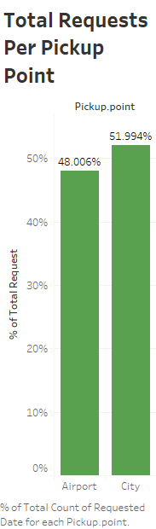
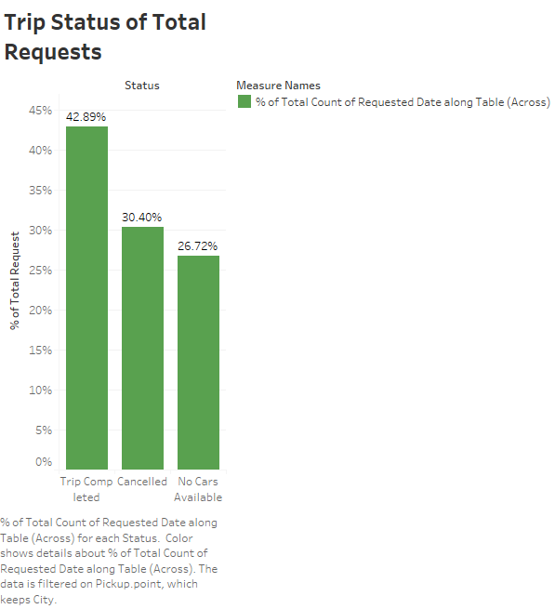
Univariate Analysis
Trips Requested from City are more than the Airport by 4%.
The status of Cancelled trips are more than the No Cars of the available. Over all only 43% of the trips requested are completed. Uber is missing 57% of requests received.

Slide 6
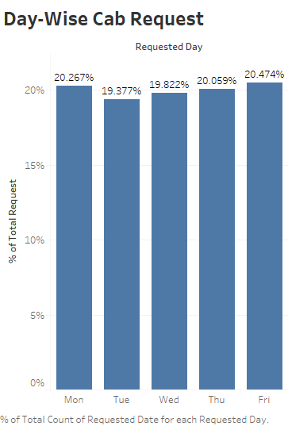
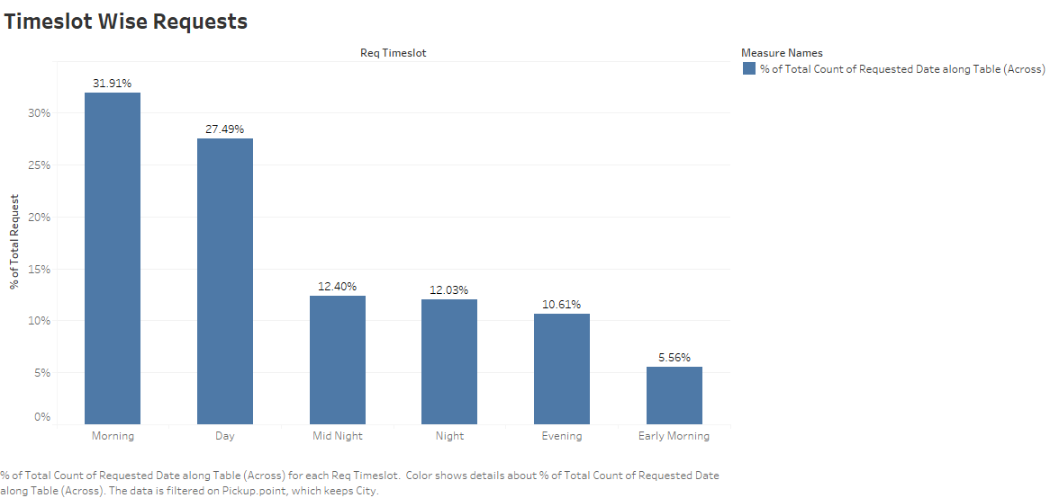
Univariate Analysis
There are request flow in more between 7 Am – 12 PM.
Day/Date wise there is no Significant change in the inflow of Cab Requests.
All the 5 Days of the week have uniformity of the demand.

Slide 7
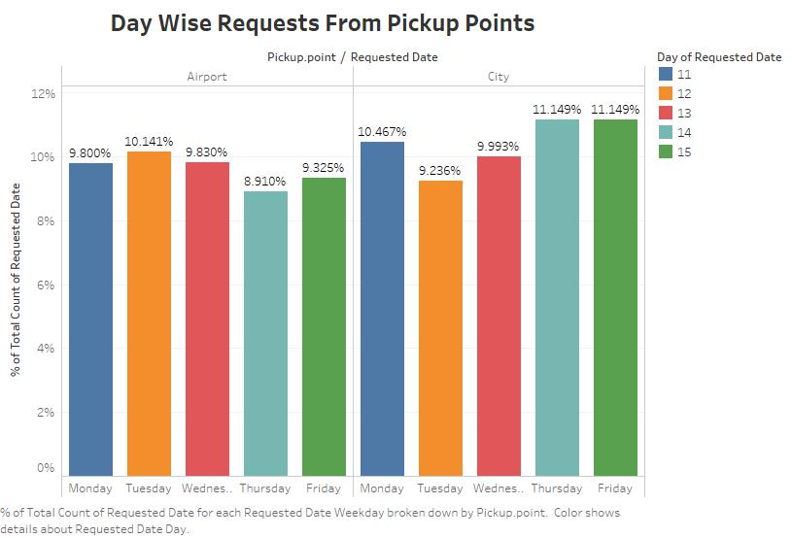
Segmented Univariate Analysis
Observations :
Overall the demand is more from City.
Thursday & Friday have the highest almost equal demand from city and 2nd highest from city being Monday. As per this we can these 3 days are being prime days of receiving the high request of cabs.

Slide 8
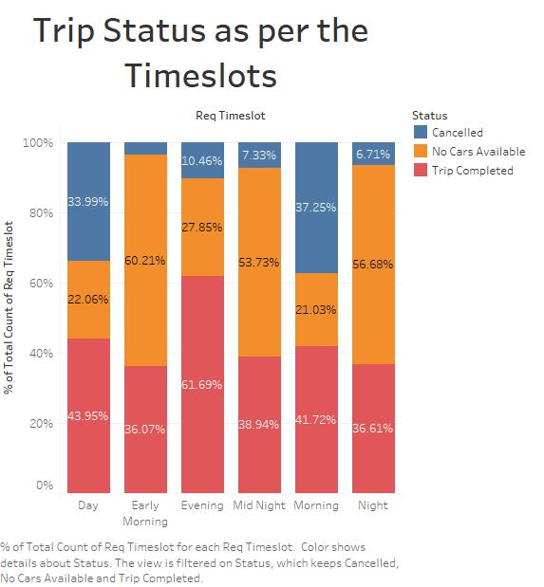
Segmented Univariate Analysis
Observations :
Around 60.21% of the cabs requests were not met the supply during the early morning hours (Between 3am – 7 am).
The Cancellation is high during 7am to 4 pm of the day.

Slide 9
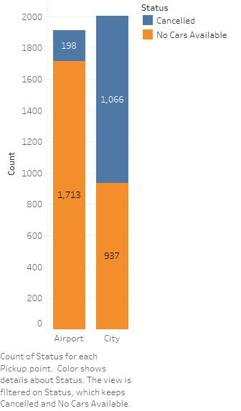
Bivariate Analysis
Observation:
The lack of availability of cars from airport is big in number which is 1713.
And on another side the trips gets cancelled from city are 1066.

Slide 10
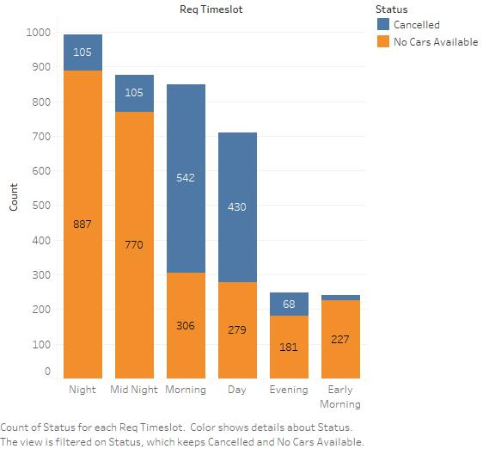
Bivariate Analysis
Observation:
The demand is not met due to lack of cars availability is more during Night ,Mid Night & Morning.
Trips gets cancelled more in the Morning and Day time.

Slide 11
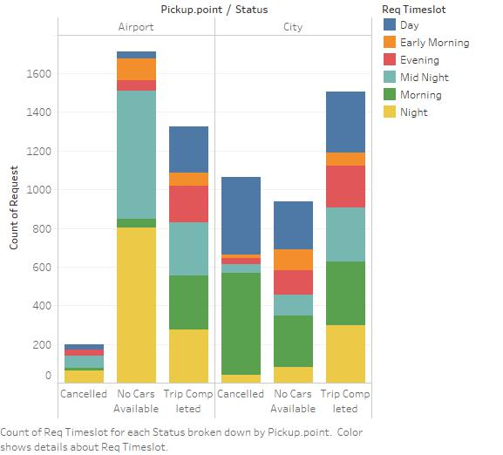
Bivariate Analysis
Observation:
Here, we find that there is huge amount of gap in the demand & Supply of cabs due lack of availability of cars from airport during Night & Mid Night.
The Cancellation of Cabs are seen more from city during Morning & Day request received from city to airport.

Slide 12
Conclusions
Key Observations for Difference between Demand – Supply Gap :
The demand is high from City as compared to Airport, whereas finding says most of the cabs gets cancelled is also high during morning & day hours at city due to which gap is increasing.
Another major demand is from Airport, but the lack of availability of cars the during Night Hours.
There might be other factors of receiving less demand when cars are available like price per trip & lack of coordination with flights arrival & Departure timings.

Slide 13
Conclusions
Recommendations :
Coordination of availability of cabs at airport with the flights time-table.
Introducing the schemes for drivers for encouraging the trips to pursue from city for airports.
Introducing offers/fees for drivers in order to control cancellation trips.
Other Variables can increase the Gap are : –
Charges
Fairs
Cancellations Initiators ( customer/Drivers)
Peak Traffic Hours.

